Slide 1
Artificial Intelligence Project
Shishir Suman(RA1911033010143)
Ayush Sharma(RA1911033010144)
Satvik Srivastav(RA1911033010155)

Slide 2
Lane Detection
Abstract
Autonomous vehicles and advanced driver assistance systems are predicted to provide higher safety and reduce fuel and energy consumption and road traffic emissions. Lane detection and tracking are the advanced key features of the advanced driver assistance system. Lane detection is the process of detecting white lines on the roads. Lane tracking is the process of assisting the vehicle to remain in the desired path, and it controls the motion model by using previously detected lane markers.

Slide 3
Issues in Existing System
Lane markings are usually yellow and white, although reflector lanes are designated with other colors. The number of lanes and their width varies per country. Due to the existence of shadows, there may be problems with vision clarity. The surrounding cars may obstruct the lane markings. Likewise, there is a dramatic shift in lighting as the car exits a tunnel. As a result, excessive light has an impact on visual clarity. Due to different weather conditions such as rain, fog, and snow, the visibility of the lane markings decreases. In the evening, visibility may be reduced. These difficulties in lane recognition and tracking lead to a drop in the performance of lane detection and tracking algorithms. Therefore, the development of a reliable lane detecting system is a challenge.

Slide 4
Problem Statement
We have four lanes separated by white-colored lane markings. So, to detect a lane, we must detect the white markings on either side of that lane. This leads to the key question – how can we detect the lane markings?There are so many other objects in the scene apart from the lane markings. There are vehicles on the road, road-side barriers, street-lights, etc. And in a video, a scene changes at every frame. This mirrors real-life driving situations pretty well.So, before solving the lane detection problem, we have to find a way to ignore the unwanted objects from the driving scene.One thing we can do right away is to narrow down the area of interest. Instead of working with the entire frame, we can work with only a part of the frame. In the image below, apart from the lane markings, everything else has been hidden in the frame. As the vehicle would move, the lane markings would fall more or less in this area only:

Slide 5
Objective
Grayscale conversion of image: The video frames are in RGB format, RGB is converted to grayscale because processing a single channel image is faster than processing a three-channel coloured image.
Reduce noise: Noise can create false edges, therefore before going further, it’s imperative to perform image smoothening. Gaussian filter is used to perform this process.
Canny Edge Detector: It computes gradient in all directions of our blurred image and traces the edges with large changes in intensity. For more explanation please go through this article: Canny Edge Detector
Region of Interest: This step is to take into account only the region covered by the road lane. A mask is created here, which is of the same dimension as our road image. Furthermore, bitwise AND operation is performed between each pixel of our canny image and this mask. It ultimately masks the canny image and shows the region of interest traced by the polygonal contour of the mask.
Hough Line Transform: The Hough Line Transform is a transform used to detect straight lines. The Probabilistic Hough Line Transform is used here, which gives output as the extremes of the detected lines

Slide 6
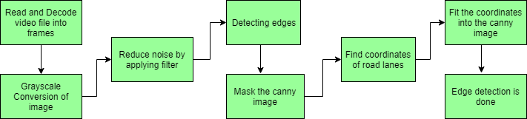
Proposed Methodology

Slide 7
Algorithm Used
Canny-Hough Detector
The lines on the road that show us where the lanes are act as our constant reference. We are using canny detector-Hough transform based lane detection.Fundamental idea is to detect sharp changes in luminosity such as shift from black to white, white to black & will define it as edges. Noise reduction, Intensity Gradient, Non-Maximum suppression, Hysteresis thresholding. It have 3 parameters.
The img parameter defines the image that we’re going to detect edges on.
The threshold-1 parameter filters all gradients lower than this number (they aren’t considered as edges).
The threshold-2 parameter determines the value for which an edge should be considered valid.
Any gradient in between the two thresholds will be considered if it is attached to another gradient who is above threshold-2.
The hough transform technique is an amazing tool that can be used for locating shapes in images. It is often used to detect circles, ellipses, and lines to get the exact location or geometrical understanding of the image. This ability of the Hough transform to identify shapes makes it an ideal tool for detecting lane lines for a self-driving car

Slide 8
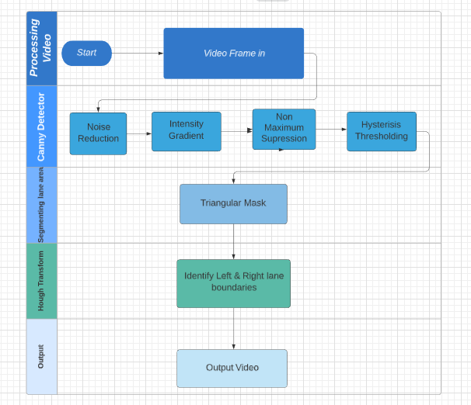
Process flow of Canny-Hough detector

Slide 9
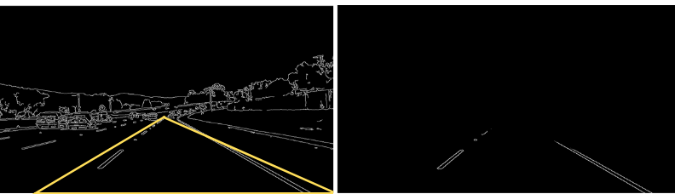
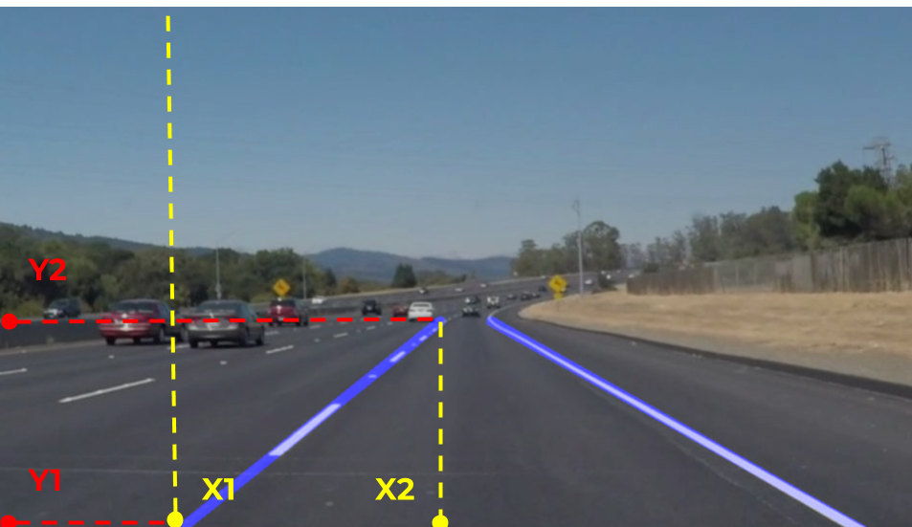
Demo and Screenshot

Slide 10
Societal Benefits
These systems will quickly alert the driver if their vehicle should cross over the line dividing lanes, thereby helping to avoid an accident. Like many other safety features, creators of this technology claim that it will help prevent car accidents.The results of this study back up the claims that these systems are effective at reducing the number of auto accidents. Research shows that when used correctly, lane departure warning systems can decrease these types of accidents by as much as 21%.

